Slide 1
C
CATAWBA COLLEGE
DATA MINING · FINAL PROJECT
Predicting Heart Disease
Supervised Learning · End-to-End Modeling Workflow
PROJECT TITLE
STUDENT NAME
DATE
Predicting Heart Disease
Eric Bass
4/29/2026
CIS 3902

Slide 2


CATAWBA COLLEGE
01 · PROBLEM
Problem Statement & Objective
Frame the problem, clarify the target, justify the work
01
Motivation
Addressing heart disease is critical because it remains the leading cause of death globally.
Introduction
While heart disease is a global health crisis, this project is personal for me. Heart disease runs in my family, and I wanted to use data science to understand which clinical indicators are the most reliable predictors for early intervention.
02
Prediction Target
I am predicting the presence or absence of heart disease in a patient.
03
Impact
Medical organizations and clinicians would be able to save countless lives every year.
Data Mining · Final Project
1 / 10

Slide 3




CATAWBA COLLEGE
02 · DATASET
Dataset & Domain Context
Where the data comes from and why it fits the problem
AT A GLANCE
Source & Citation
Janosi, A., Steinbrunn, W., Pfisterer, M., & Detrano, R. (1988). Heart Disease [Dataset]. UCI Machine Learning Repository. | https://archive.ics.uci.edu/dataset/45/heart+disease | Cleveland Clinic Foundation, Hungarian Institute of Cardiology (Budapest), V.A. Medical Center (Long Beach, CA), and University Hospital (Zurich, Switzerland).
#
rows
303
Size & Structure
#
features
Dataset: UCI Heart Disease Key Predictors:
Size: 303 Rows | 14 Columns Clinical: Chest Pain, Blood Pressure, Cholesterol
Integrity: 100% (No missing values) Biometric: Max Heart Rate, ST Depression (ECG)
Type: Binary Classification (Target: 0 vs. 1) Demographic: Age, Sex
14
—
target type
Domain Relevance
Classification
This dataset is a clinical benchmark from the UCI repository that features high-relevance metrics like chest pain type and max heart rate, making it a reliable foundation for validating predictive models.
This is a small dataset
Data Mining · Final Project
2 / 10

Slide 4

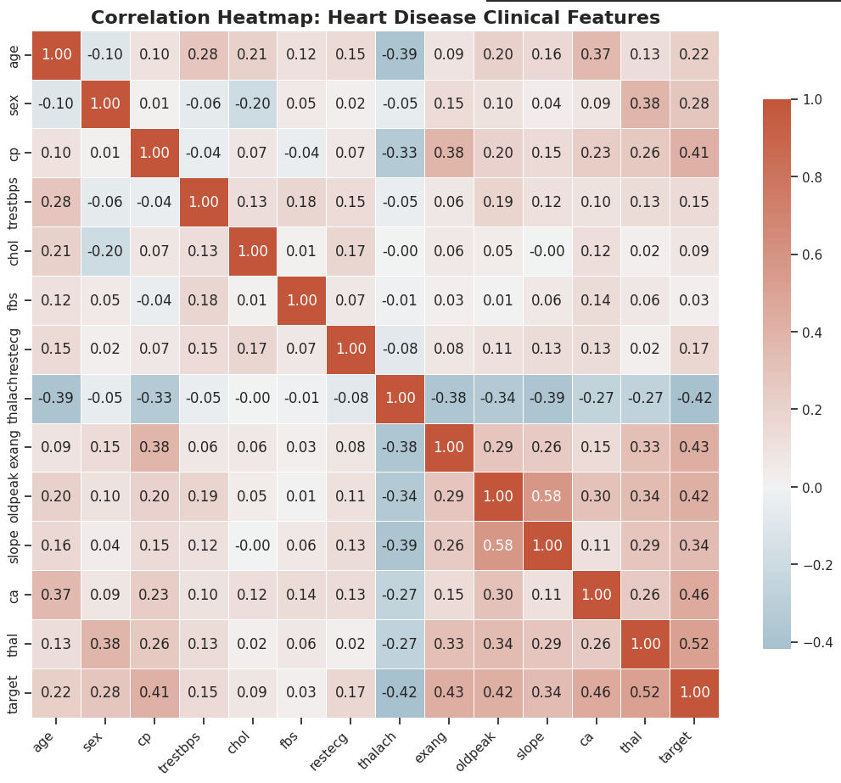

CATAWBA COLLEGE
03 · EXPLORATION
Data Exploration & Key Insights
What the data reveals before any modeling happens
WHAT TO COVER
Summary statistics
Averages: Typical patient: 54 years old, mean cholesterol of 246 mg/dl and resting blood pressure of 131 mm Hg.
Medians: The median values closely align with the means.
Spread: There is significant variability in cholesterol (standard deviation of ~52) and max heart rate (~23), indicating a diverse range of patient health profiles.
Visuals
This correlation heatmap illustrates the linear relationships between my features and identifies how strongly each variable relates to the presence of heart disease.
[ Paste your EDA visualization here ]
Histogram · Correlation heatmap · Scatter · etc.
Notable trends & outliers
Serum cholesterol (chol) and resting blood pressure (trestbps) features contain noticeable outliers, such as cholesterol levels exceeding 400 mg/dl and blood pressure readings above 170 mm Hg. These values are clinically extreme and could either represent rare high-risk cases or potential data entry errors from the 1980s collection period.
Data Mining · Final Project
3 / 10

Slide 5


CATAWBA COLLEGE
04 · PREPARATION
Data Cleaning & Feature Engineering
From raw dataframe to model-ready matrix
01
Handle Missing Data
02
Encoding & Discretization
03
New Feature Creation
Major Vessels Colored (ca) and Thalassemia (thal). These were imputed because they are high-priority predictors for heart disease, and retaining the rows was more beneficial for the model's training than dropping them from the small sample of observations.
I applied One-Hot Encoding to categorical variables such as chest pain type and thalassemia using a ColumnTransformer pipeline. This ensured the model treated these categories as distinct entities rather than ranked values. Additionally, I standardized continuous features like age and cholesterol using a StandardScaler to ensure all numerical inputs were on a comparable scale.
I intentionally chose not to create new features to maintain the clinical integrity of the original UCI dataset, as the existing variables are already recognized as medical "gold standards." Given the small sample size of 303 rows, this decision also prevented unnecessary model complexity and reduced the risk of overfitting.
Data Mining · Final Project
4 / 10

Slide 6

CATAWBA COLLEGE
05 · METHOD
Model Selection & Method
The algorithm, the reasoning, the tooling
ALGORITHM
Why This Choice?
Random Forest
Random Forest because it is a powerful ensemble algorithm that captures non-linear relationships and handles mixed feature types without requiring extensive preprocessing. Additionally, it provides built-in feature importance rankings, which allowed me to validate that the model’s mathematical logic.
FAMILY
Supervised · Ensemble · Tree-based
Tools & Libraries
ALTERNATIVES CONSIDERED
Logistic Regression · Nearest Neighbor · Decision Tree
PyCaret
scikit-learn
pandas
matplotlib
AutoViz
Data Mining · Final Project
5 / 10

Slide 7

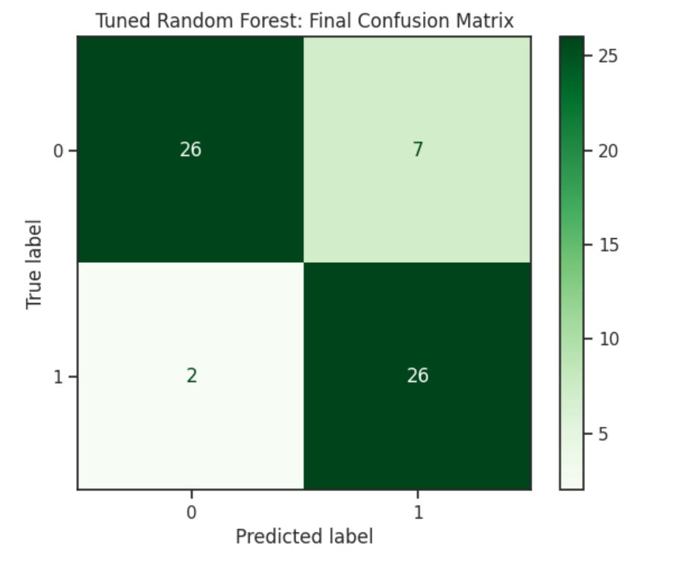

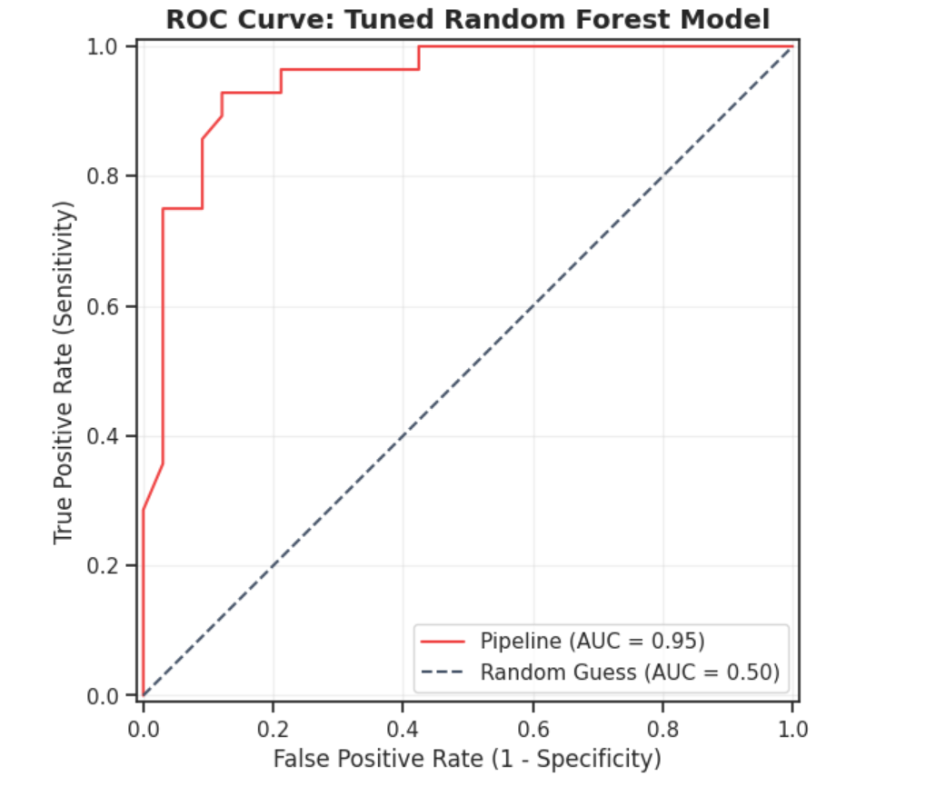
CATAWBA COLLEGE
06 · EVALUATION
Model Evaluation & Tuning
How well it works — and how you made it better
0.918
0.90
ACCURACY
AUC
[ Screenshot: Confusion Matrix ]
Overall correctness
Ranking quality
Confusion Matrix
0.92
0.88
PRECISION
RECALL
Of predicted positives
Of actual positives
[ Screenshot: ROC Curve ]
HYPERPARAMETER TUNING
ROC Curve
Data Mining · Final Project
6 / 10

Slide 8

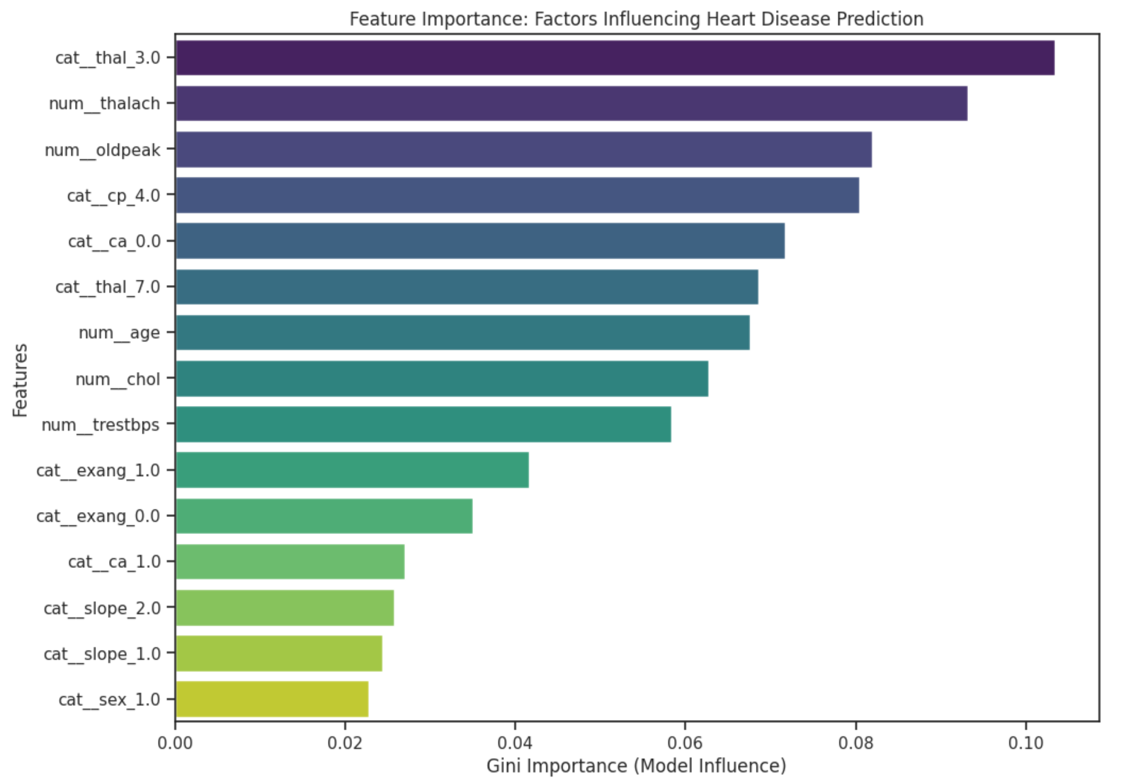
CATAWBA COLLEGE
07 · INTERPRETATION
Feature Importance & Interpretation
Which features drive the predictions, and what it means
TOP FEATURES
1
Cat_thal_3.0
2
Num_thalach
[ Feature importance plot ]
3
Num_oldpeak
4
Cat_cp_4.0
INTERPRETATION
5
Cat_ca_0.0
The model’s decision-making is most heavily influenced by Cat_thal_3.0, Num_thalach, Num_oldpeak, Cat_cp_4.0, and Cat_ca_0.0. While these align with medical intuition, the project is limited by its 1980s-era data and a significant male-representation bias.
Data Mining · Final Project
7 / 10

Slide 9


CATAWBA COLLEGE
08 · REFLECTION
Limitations & Next Steps
What’s imperfect, what’s next
LIMITATIONS
ETHICS & BIAS
ROADMAP
Model Limitations
Data Issues & Bias
Future Work
My model primarily struggles with the small sample size of 303 observations, which can lead to instability and overfitting during the training process. Additionally, the historical nature of the data from the 1980s may not fully capture modern diagnostic complexities or reflect the clinical diversity found in contemporary global populations.
This dataset has significant representation problems, particularly regarding gender and geographic diversity. Males are disproportionately represented compared to females, which could lead the model to develop a bias that makes it less accurate for women. Furthermore, because the data was collected in the 1980s from specific locations in the U.S. and Europe, it lacks the ethnic and modern demographic variety needed to generalize the results to a diverse, global population today.
To improve this project in the future, I would prioritize expanding the dataset to include more diverse, modern patient records to ensure the model generalizes better across different ethnicities and age groups.
Data Mining · Final Project
8 / 10

Slide 10



CATAWBA COLLEGE
09 · REFERENCES
References & Acknowledgments
Include use of AI
DATA SOURCES
GITHUB REPOSITORY
[ QR CODE ]
Janosi, A., Steinbrunn, W., Pfisterer, M., & Detrano, R. (1988). Heart Disease [Dataset]. UCI Machine Learning Repository. | https://archive.ics.uci.edu/dataset/45/heart+disease
Scan to view code, data & notebooks
Google Gemini AI
Issues · Pull Requests welcome
TOOLS & LIBRARIES
Python
PyCaret
scikit-learn
pandas
THANK YOU
matplotlib
AutoViz
Questions welcome.
Acknowledgments: Dr. Pamela Thompson | Eric Bass | Janosi, A., Steinbrunn, W., Pfisterer, M., & Detrano, R.
Data Mining · Final Project
10 / 10
Data Mining · Final Project
10 / 10

